Slide 1
Developing Integration Solutions using Microsoft BizTalk Server 2013
Day 4 Key Learnings

Slide 2
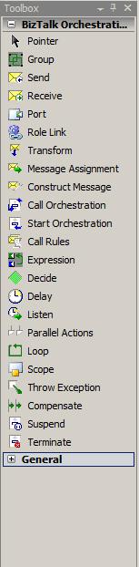
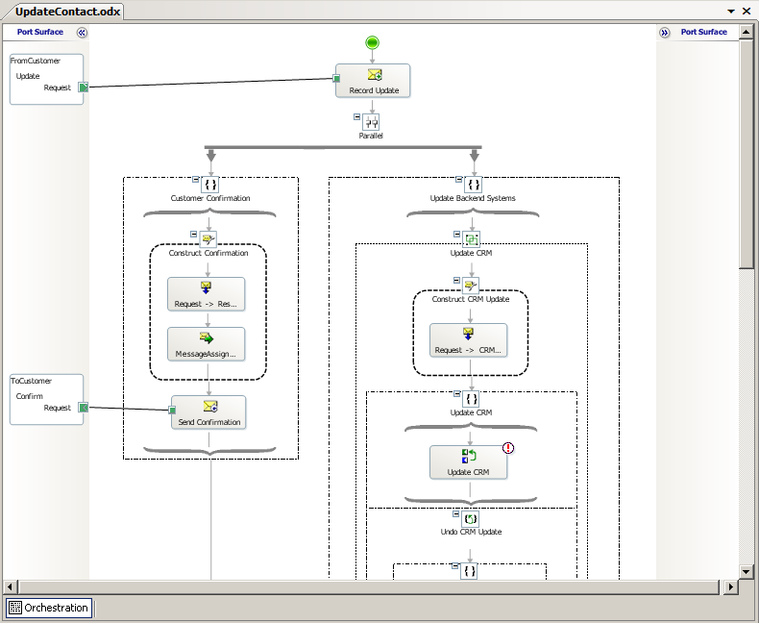
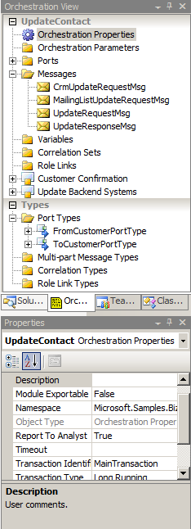
Orchestration Designer
Design Surface
Visual Designer
Pre-defined shapes
Drag-drop-configure
Not extensible, but the Expression shape allows you to do basically anything.
Orchestration view
Toolbox
Property Window
Port Surface

Slide 3

Using the Expression shape
Use Expression shape to
Enter simple XLANG/s (C#) statements.
Do variable manipulation.
Extract message data through xpaths
Make .NET calls to external API’s
Including BizTalk Server API’s

Slide 4
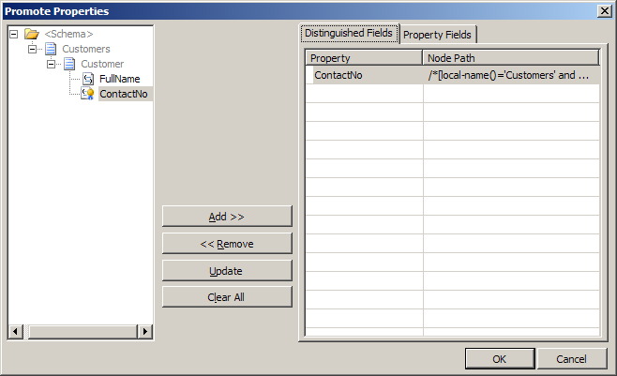

Simplifying Expressions using Distinguished fields
Distinguished fields
Aliases for xpath statements
Lightweight, better performance then promoted fields
Fields are made distinguished through the Promote Properties dialog.
CustomerMessage.Customer.ContactNo = "123";
Caution!
As Distinguished fields are stored in the message together with the namespace, the context of the message can grow much bigger then the message it self.

Slide 5



Correlating messages
Hint!
Working with correlation sets
Orchestration
Correlation sets are the only way to promote properties in a message published by an orchestration.
Send
Order
- Nummer
Kund
ID
Namn
Typ
...
- Datum
OrderRader
- OrderRad
- ...
.
Initialize correlation set
MsgBox
Correlation Set
OrderID
Instance subscription
Faktura
- Nummer
- OrderNoRef
Kund
ID
Namn
...
- Datum
FakturaRader
FakturaRad
...
.
Receive
Follow correlation set
Notes:
Correlation Types are made up out of properties from propertyschemas.
The picture above is therefore only partially true.

Slide 6
Convoys
What is a convoy?
When multiple single messages must be related to achieve the result
Type of convoys
Sequential
Parallel
Item 1
Item 1
Item 2
Item 3
Item 2
Action
Item 3
Action
Notes:
Sequntial explanation: Cars with blue flags going to a a common location. All receives must be connected to the same Port and receive the same MessageType.
Parallell explanation: A door with many locks that only three keys will unlock. Can be in different order. Can be of different type.

Slide 7
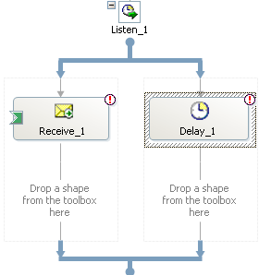
The concept of Zombies
What is a zombie?
Sequential convoy
Receive
A zombie message is a message routed to a running orchestration where the orchestration ended before the message could be delivered.
A zombie service instance is an instance of an orchestration that completed without consuming all of it’s messages.
While < 3 message received
Receive
Add to
Batch
Submit
Batch
Example of situations that can cause zombies
Terminate control messages
Listen shape with a receive and a delay
Convoys

Slide 8

Persistence
Persistence
Saves the entire state of the orchestration to the database.
Provides reliable recovery and resource optimization.
Persistence is expensive!
You can sometimes control when persistence occurs!
Dehydrate
Persistence points
End of transactional scope
At debugging breakpoints
At Start Orchestration and Send shapes
When the orchestration is suspended
On controlled shutdown of BizTalk
When the orchestration finishes
When the engine determines it appropriate
Rehydrate
MsgBox

Slide 9
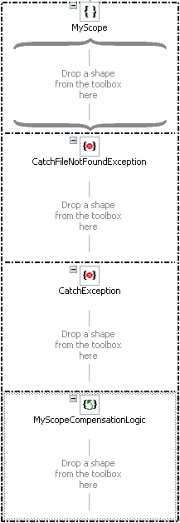
The Scope shape
Transaction type
None
Long Running
Atomic
Contains any number of shapes
Exception handlers
Compensation

Slide 10


Binding Orchestrations
Orchestration
Logical Receive Port
Logical Send Port
Direct
Bind
Bind
Message Box
Physical Receive Port
Physical Send Port

Slide 11


About transactions in BizTalk Server
Transactional Orchestration
Transactional COM+ Component
Receive
Receive Port
Send Port
TransactionalAdapter
Atomic Scope
Send
Expression
Send
Message Box

Slide 12
Orchestration states
Start
Unenlisted (unbound)
Enlist
Start
Unenlisted / Bound
Stopped
Started
Setup Bindings
Unenlist
Stop
Unenlist

Slide 13
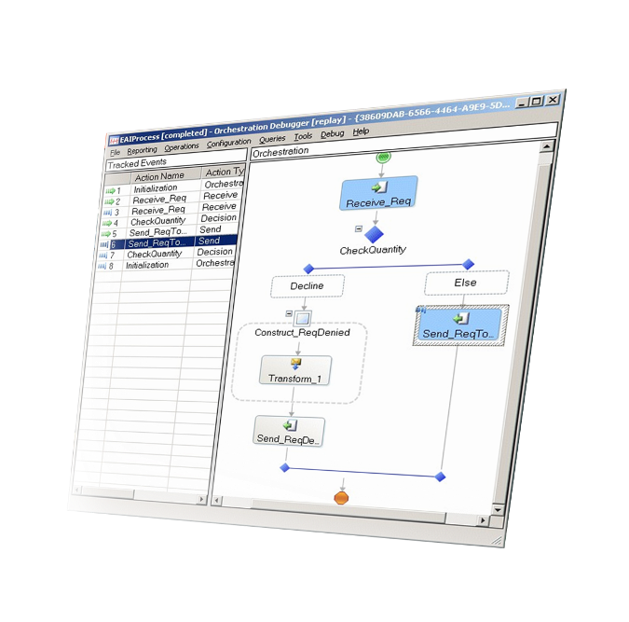
Orchestration Debugger
Debugging
View orchestration instances and messages
Set breakpoints
Suspend, terminate, or resume processes
View variables and data
Orchestration Debugger

Slide 14
Orchestration Service Instance States
Service Instance States
State | Explanation
In Breakpoint | Orchestration has hit a breakpoint set in the Orchestration Debugger.
Ready to run | An activated instance that has not yet started running, normally due to throttling or unavailability of resources.
Active | Executing service instance.
Dehydrated | Persisted in the database waiting to be activated.
Pending suspend/Pending terminate | A control message has been submitted but not yet picked up by the instance.
Suspended (resumable) | Suspended, can be resumed.
Suspended (not-resumable) | Suspended, can not be resumed.
Completed with discarded messages | Instance completed without consuming all of it’s messages, leaving ”Zombies” behind.

Slide 15
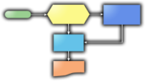
Monitoring your processes
What is the average processing duration for orders?
What is the order trend for product XYZ over the past 24 hours?
How many orders processed were over $1,000?
BAM
Primary Import
Received
Approved
Declined

Slide 16



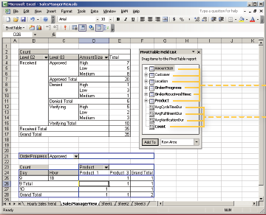




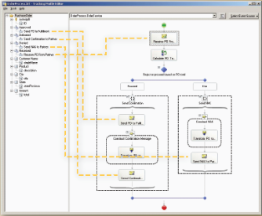
Business Activity Monitoring (BAM)
1
Identify KPIs
2
”The Business Analyst”
System Administrator
Deploy
4
View
3
Connect
BAM
”Information Worker”
Developer

Slide 17





Common Orchestration scenarios for Business Rules
Routing
Decision making
Process engine (step based execution)
Rule based delay
Configuration storage

Slide 18
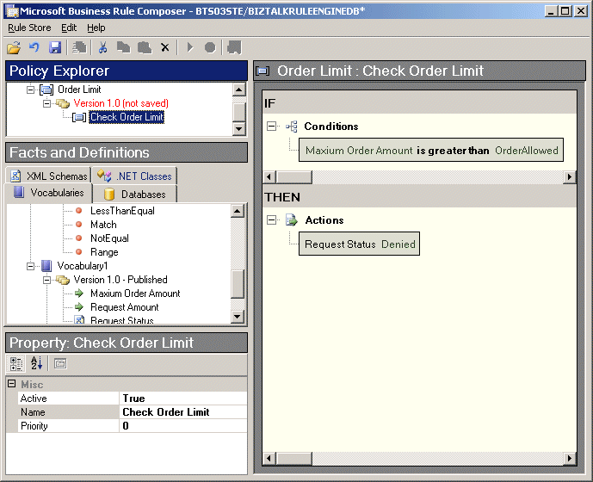
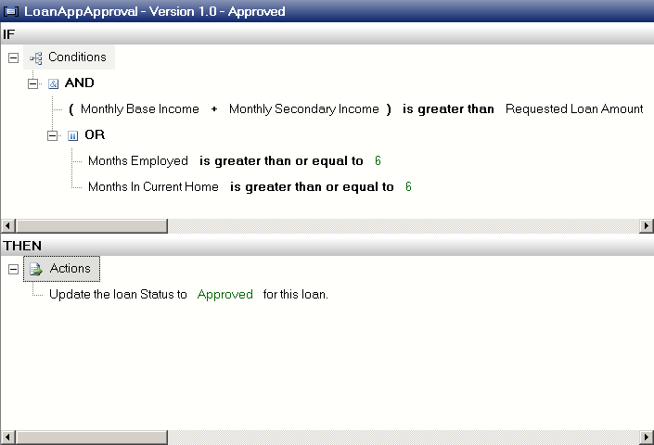

Business Rules Engine (BRE)
1
2
Identify Business Logic & Data Sources
3
7
Developer
Business Analyst
Use policy in orchestration
4
Define Vocabularies and Rules
8
Deploy & Publish
Rule Store
Design and Test Policies
5
6
Information worker
Administrator

Slide 19
Course Outline
Module 1: Introduction to BizTalk Server
Module 2: Schemas
Module 3: Maps
Module 4: Testing and Deploying Projects
Module 5: Pipelines
Module 6: Routing
Module 7: Adapters
Module 8: Web Services and WCF
Module 9: Introduction to Orchestrations
Module 10: Applied Orchestration Techniques
Module 11: Business Activity Monitoring
Module 12: Integrating Business Rules
Module 13: Deploying and Managing Applications
Module 14: Working with Workflow and AppFabric
Friday

